Slide 1





NLP with Machine Learning and Deep Learning
SESSION 6 · THEORY AND SELF-LEARNING
SESSION
6
Notes:
This session moves from the statistical models of Session 5 to neural (deep learning) models: the textbook's third generation of NLP. Reference text: Bhattacharyya & Joshi, Natural Language Processing (Wiley India, 2023), §1.4 on the generations of NLP and the neural-approach sections of the task chapters (e.g. neural POS tagging and neural parsing).

Slide 2
Session outline
OVERVIEW
I
Machine learning and deep learning for NLP
Learning from data; feature engineering vs representation learning; word embeddings
II
ML vs DL, with the algorithms
A side-by-side comparison; named algorithms in each family; real results on the same data
III
Linear algebra review
Vectors, matrices, dot products and cosine similarity; layers as matrix products; activations and gradients
IV
From neurons to LSTM
Feedforward networks, RNNs, the vanishing gradient, and the LSTM cell, gate by gate
SL
Self-learning (2 hours)
A guided notebook: NumPy linear algebra, word vectors, one LSTM step by hand, RNN vs LSTM training
Learning outcomes. Distinguish ML from DL and name the main algorithms of each, use the linear algebra behind neural networks, and explain how an LSTM processes a sentence.
Notes:
2 hours of theory. The self-learning notebook (2 hours) reinforces every part and reproduces the real results shown on the slides.

Slide 3
Where we are: the third generation of NLP
OVERVIEW
Rules
Statistical ML
Deep learning
1950s–1980s
linguists write grammars and lexicons
1990s–2000s
counts, probabilities and hand-made features (Session 5)
2013 onward
neural networks learn the features themselves
MILESTONES OF NEURAL NLP
1997
2003
2013
2014
2017
2018
2020s
LSTM
Hochreiter & Schmidhuber
Neural LM
Bengio et al.
word2vec
Mikolov et al.
Seq2seq
LSTM encoder–decoder MT
Transformer
Vaswani et al.
BERT, GPT
pre-train, then fine-tune
LLMs
instruction-tuned chat models
Today. The ideas that made generation 3 possible: learned vector representations, the linear algebra that manipulates them, and the LSTM, the workhorse of neural NLP from 2014 to 2018.
Notes:
Textbook §1.4 Generations of NLP. Highlight that the LSTM was invented in 1997 but became dominant only when data and GPUs caught up, around 2014.

Slide 4

ML and deep learning for NLP
I
Learning a function from text to labels, and learning the representation too

Slide 5
What machine learning means for NLP
I · MACHINE LEARNING AND DEEP LEARNING FOR NLP
Learn a function f : x → y from examples, instead of writing the rules by hand.
KIND OF LEARNING | WHAT THE DATA LOOKS LIKE | NLP EXAMPLE
Supervised | inputs with labels | sentiment, spam, POS tagging, NER
Unsupervised | inputs only | clustering reviews, topic models
Semi-supervised | a few labels, much raw text | self-training a tagger
Self-supervised | labels made from the text itself | predict the next word: how word2vec, BERT and GPT are pre-trained
Reinforcement | rewards for actions | dialogue policies; tuning chat models from human feedback
The common recipe. Choose a model with parameters θ → define a loss L(θ) that measures errors on training data → adjust θ to reduce L → check on held-out test data.
Notes:
Self-supervision is the key idea behind modern deep NLP: unlimited 'labels' come free from raw text, which is why large pre-trained models are possible.

Slide 6
Feature engineering vs representation learning
I · MACHINE LEARNING AND DEEP LEARNING FOR NLP
CLASSICAL MACHINE LEARNING
Review text
Hand-made features
n-grams, POS, lexicons
Classifier
NB, MaxEnt, SVM
Label
A person decides which features matter. The model only learns their weights.
DEEP LEARNING
Review text
Embeddings
learned word vectors
Neural layers
RNN, LSTM, Transformer
Label
The network learns the representation and the decision together, end to end, from data.
Trade-off. Hand-made features need expertise but little data. Learned representations need much more data (or pre-training) but find patterns no one thought to encode, such as negation and word order.
Notes:
This is the single most important difference between ML and DL. Session 5's classifiers all used bag-of-words features designed by us.

Slide 7
From sparse one-hot vectors to dense embeddings
I · MACHINE LEARNING AND DEEP LEARNING FOR NLP
ONE-HOT (SPARSE)
One position per vocabulary word; 20,000+ dimensions; every pair of words is equally different.
movie
0
0
0
1
0
0
0
0
0
0
0
0
… 20,000
cosine(movie, film) = 0
film
0
0
0
0
0
0
0
1
0
0
0
0
… 20,000
DENSE EMBEDDING (REAL spaCy en_core_web_lg VECTORS, FIRST 6 OF 300 DIMENSIONS)
Every dimension carries some meaning; similar words get similar vectors.
movie
0.21
-0.48
0.15
-0.39
0.48
0.6
… 300
cosine(movie, film) = 0.79
film
0.31
-0.31
0.43
0.14
0.45
0.53
… 300
Distributional hypothesis. “You shall know a word by the company it keeps” (Firth, 1957). Embeddings are learned by predicting words from their neighbours (word2vec, GloVe, fastText).
Notes:
The dense values and the 0.79 cosine are real (spaCy en_core_web_lg, 300-d GloVe-style vectors). Self-learning notebook Part 2 reproduces them.

Slide 8
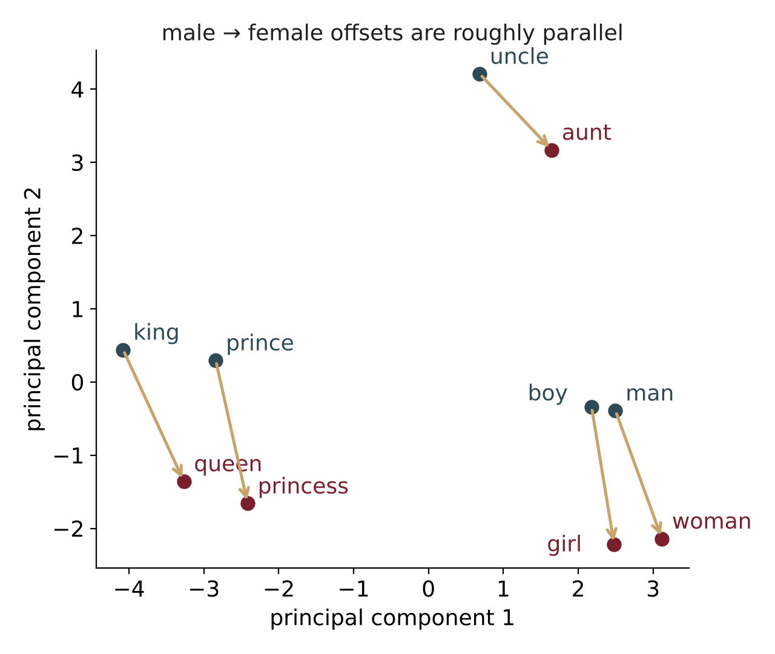
Embeddings capture meaning as geometry
I · MACHINE LEARNING AND DEEP LEARNING FOR NLP
Vector arithmetic
king − man + woman ≈ ?
NEAREST WORD (REAL) | COSINE
queen | 0.788
prince | 0.640
princess | 0.613
royal | 0.580
throne | 0.579
Spelling variants of “king” itself (KIng, KINGS) were excluded, as is standard.
Why it matters: a network fed these vectors already ‘knows’ that movie ≈ film and great ≈ excellent, so it needs fewer labelled examples.
Real 300-d vectors projected to 2-D with PCA.
Notes:
All values are real outputs of spaCy en_core_web_lg most_similar. Caution students that embeddings also absorb social biases from their training text (e.g. gender stereotypes in occupations).

Slide 9

ML vs DL: the algorithms
II
What differs, which algorithms belong to each family, and how they compare on the same data

Slide 10
Machine learning vs deep learning
II · ML VS DL: THE ALGORITHMS
 | CLASSICAL MACHINE LEARNING | DEEP LEARNING
Features | designed by hand (bag of words, n-grams, POS, lexicons) | learned automatically (embeddings, hidden layers)
Data needed | hundreds to thousands of examples | tens of thousands or more, unless pre-trained
Compute | a laptop CPU, seconds | GPUs, minutes to weeks
Word order and context | lost in a bag of words, unless n-grams are added | modelled directly (RNN, LSTM, attention)
Interpretability | high: feature weights can be read | low: distributed representations
Accuracy trend | levels off as data grows | keeps improving with data and model size
Typical models | Naive Bayes, logistic regression, SVM, CRF | CNN, RNN, LSTM, GRU, Transformer
Deep learning is a subset of machine learning: models with many layers that learn their own representations.
Notes:
Emphasise that 'ML vs DL' is not either/or: logistic regression is a one-layer neural network, and DL models end in a softmax classifier.

Slide 11
Classical ML algorithms used in NLP
II · ML VS DL: THE ALGORITHMS
ALGORITHM | TYPE | TYPICAL NLP USE | SEEN IN
Naive Bayes | generative classifier | spam filtering, sentiment baseline | Session 5
Logistic regression (MaxEnt) | discriminative classifier | text classification, tagging features | Session 5
Support vector machine | maximum-margin classifier | text categorisation | Session 5
Decision tree, random forest | rule-like / ensemble | feature-rich tasks, small data
Gradient boosting (XGBoost) | ensemble of trees | ranking, tabular + text features
k-nearest neighbours | instance-based | similarity search, simple classification
Hidden Markov model | generative sequence model | POS tagging, speech | Sessions 3, 5
Conditional random field | discriminative sequence model | named entity recognition | Session 4
k-means, LDA | unsupervised | clustering, topic modelling | Session 5
All take a fixed feature vector per document or word: someone has to decide what goes into it.
Notes:
Most of these were covered or used in earlier sessions; the 'Seen in' column links back.

Slide 12
Deep learning algorithms used in NLP
II · ML VS DL: THE ALGORITHMS
ALGORITHM | YEAR | KEY IDEA | TYPICAL NLP USE
Feedforward network (MLP) | 1980s | stacked layers h = f(Wx + b) | classification on averaged embeddings
word2vec, GloVe, fastText | 2013–16 | dense word vectors from context | input features for every model
CNN for text | 2014 | filters slide over n-gram windows | sentence classification
Recurrent network (RNN) | 1990 | a hidden state carried word to word | language modelling (short range)
LSTM | 1997 | gates control a memory cell | tagging, NER, sentiment, MT
GRU | 2014 | simpler gated RNN (2 gates) | same as LSTM, faster
Seq2seq + attention | 2014–15 | encoder–decoder; look back at all inputs | machine translation, summarisation
Transformer | 2017 | self-attention only, fully parallel | everything: today's standard
BERT, GPT, T5 | 2018–20 | pre-train on huge text, then fine-tune | question answering, generation, chat
Today: LSTM in depth (Part IV). Next session: attention and Transformers.
Notes:
Years refer to the paper that made each idea popular in NLP: Elman 1990 (RNN), Hochreiter & Schmidhuber 1997 (LSTM), Kim 2014 (CNN), Cho et al. 2014 (GRU), Bahdanau et al. 2015 (attention), Vaswani et al. 2017, Devlin et al. 2018 (BERT), Radford et al. 2018 (GPT), Raffel et al. 2020 (T5).

Slide 13
ML vs DL on the same data: real results
II · ML VS DL: THE ALGORITHMS
On small data, ML is as good.
~10,000 short sentences is not enough for a network to beat a tuned bag-of-words model.
Pre-training is what makes DL work.
The same LSTM jumps from 70.5% to 79.1% when it starts from pre-trained word vectors.
Plain RNNs struggle.
63.1%: they forget the start of the sentence (Part IV explains why).
Cost.
ML models trained in under 1 second; each LSTM took about 40 seconds on a CPU.
10,662 movie-review sentences (half positive); 80/20 split. Slate = classical ML; maroon/grey = deep learning (PyTorch, 6 epochs).
Notes:
All numbers are real: NLTK sentence_polarity corpus (Pang & Lee), train_test_split random_state=42. ML models use TF-IDF or count unigrams + bigrams. Neural models: 300-d embeddings, 64 hidden units, dropout 0.5, Adam, 6 epochs, accuracy after the final epoch. Pre-trained embeddings: spaCy en_core_web_lg. The self-learning notebook (Parts 3 and 5) reproduces the logistic regression and the four neural results. With large data or large pre-trained models (BERT-style), deep learning pulls clearly ahead: state of the art on this dataset is above 90%.

Slide 14
Choosing between ML and DL
II · ML VS DL: THE ALGORITHMS
Prefer classical ML when …
Prefer deep learning when …
labelled data is small (hundreds to a few thousand)
you must explain each decision (legal, medical, finance)
compute or latency is limited (mobile, millions of documents a day)
a strong, quick baseline is needed before anything else
data is large, or a pre-trained model exists for your language
word order, negation and long context matter
the output is a sequence: translation, summarisation, generation
accuracy matters more than cost and interpretability
Good practice. Always build the ML baseline first. If a deep model cannot beat logistic regression, the problem is usually data size, not the architecture.
Notes:
For Indian-language NLP, check for pre-trained models (e.g. IndicBERT, MuRIL) before choosing: their availability often decides the question.

Slide 15

Linear algebra review
III
The mathematics every neural network runs on

Slide 16
Scalars, vectors, matrices, tensors
III · LINEAR ALGEBRA REVIEW
Scalar
Vector
Matrix
Tensor
0-D · a number
a word's index: 4,213
1-D · a list of numbers
one word: 300 values
2-D · rows × columns
a sentence: 12 words × 300
3-D+ · stacked matrices
a batch: 64 × 12 × 300
OPERATIONS YOU WILL SEE CONSTANTLY
OPERATION | NOTATION | SHAPES | NLP MEANING
Transpose | Xᵀ | (m × n) → (n × m) | switch rows and columns
Matrix product | XW | (m × n)(n × p) → (m × p) | apply a layer to every word at once
Element-wise product | a ⊙ b | same shapes | gating in an LSTM
Notes:
The shape rule (m × n)(n × p) is the most common source of bugs in neural network code: inner dimensions must match.

Slide 17
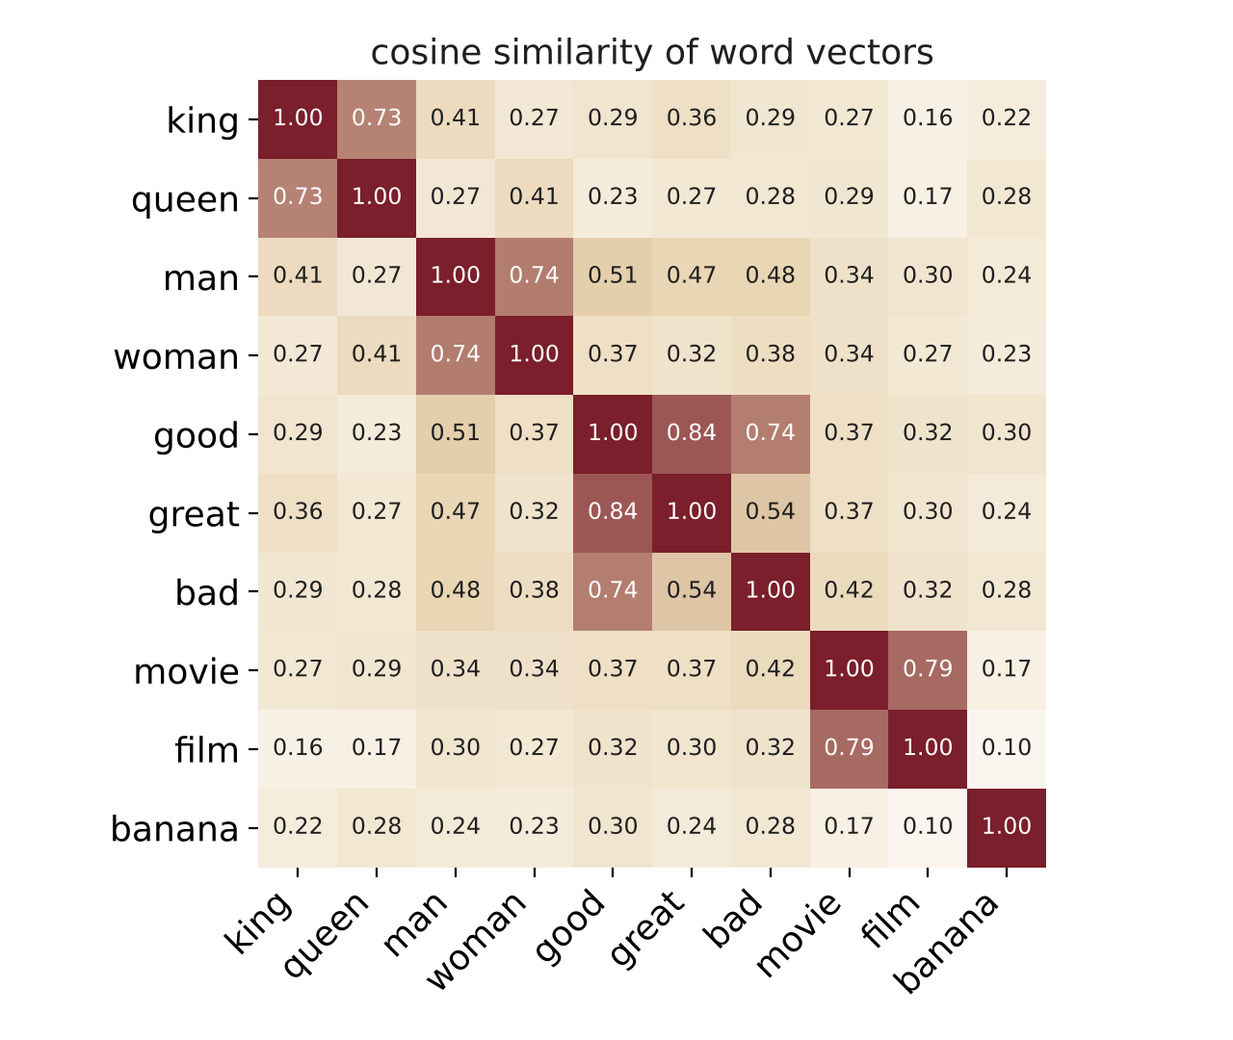
Dot product, length and cosine similarity
III · LINEAR ALGEBRA REVIEW
a · b = Σ aᵢ bᵢ
‖a‖ = √(a · a)
cos(a, b) = a · b / (‖a‖ ‖b‖)
WORKED EXAMPLE
a = (1, 2, 0), b = (2, 1, 1)
a · b = 1×2 + 2×1 + 0×1 = 4
‖a‖ = √5 = 2.24, ‖b‖ = √6 = 2.45
cos(a, b) = 4 / (2.24 × 2.45) = 0.73
Range: 1 = same direction, 0 = unrelated, −1 = opposite. Cosine ignores length, so a frequent word and a rare word can still be similar.
Real spaCy en_core_web_lg vectors. Note good–bad = 0.74: opposites share contexts.
Notes:
good and bad appear in the same contexts ('the food was ___'), so distributional vectors place them close. This is why sentiment models must fine-tune or learn on top of the embeddings.

Slide 18
A neural layer is a matrix–vector product
III · LINEAR ALGEBRA REVIEW
h = f(Wx + b)
W (2 × 3)
x (3)
b
z (2)
Each row of W is one neuron
its weights decide which input features it responds to.
Counting parameters
300-d word vectors → 64 hidden units:
W is 64 × 300 = 19,200 weights, + 64 biases = 19,264 parameters.
An embedding lookup is a product too
one-hot(word) × E selects that word's row of the embedding matrix E.
0.5
-1
0.25
×
1
+
0.1
=
1.1
1
0.5
-0.5
0
-0.2
-0.2
2
Row 1: 0.5×1 + (−1.0)×0 + 0.25×2 + 0.1 = 1.1
Row 2: 1.0×1 + 0.5×0 + (−0.5)×2 − 0.2 = −0.2
ReLU(z) = (1.1, 0) sigmoid(z) = (0.75, 0.45)
Notes:
These exact numbers are computed in self-learning notebook Part 1. A whole sentence is processed at once as a matrix product: (12 words × 300) × (300 × 64) → 12 × 64.

Slide 19
Non-linear activations and softmax
III · LINEAR ALGEBRA REVIEW
FUNCTION | RANGE | USED FOR
sigmoid σ | (0, 1) | LSTM gates; binary output
tanh | (−1, 1) | RNN/LSTM hidden states
ReLU | [0, ∞) | feedforward hidden layers
softmax | probabilities, sum 1 | choosing one of many classes or words
SOFTMAX, WORKED
softmax(zᵢ) = exp(zᵢ) / Σⱼ exp(zⱼ)
CLASS | SCORE z | PROBABILITY
positive | 2.0 | 0.659
neutral | 1.0 | 0.242
negative | 0.1 | 0.099
ReLU clipped at 2 for display.
Why non-linear? Without f, stacked layers collapse into one matrix (W₂W₁ = W), and the network could only draw straight boundaries.
Notes:
The sigmoid's slope is at most 0.25 and tanh's at most 1; multiplying many such slopes together is the root of the vanishing gradient (Part IV).

Slide 20
Derivatives and gradient descent: how networks learn
III · LINEAR ALGEBRA REVIEW
w ← w − η · ∂L/∂w
Loss L measures how wrong the predictions are (cross-entropy for classification).
Gradient ∂L/∂w a vector of partial derivatives: which direction increases the loss for each weight.
Learning rate η the step size, e.g. 0.001 with the Adam optimiser.
Backpropagation the chain rule, applied layer by layer from the output back to the input: ∂L/∂x = ∂L/∂h · ∂h/∂x
Mini-batches estimate the gradient from 64 sentences at a time, not the whole dataset.
Loss 0.693 = random guessing between two classes (ln 2).
Notes:
Loss curves are real (self-learning notebook Part 5). The random-embedding LSTM and the RNN barely move from 0.69 at first: they are still near chance. Frameworks such as PyTorch compute all gradients automatically (autograd).

Slide 21

From neurons to LSTM
IV
Feedforward networks, recurrent networks, and the long short-term memory cell

Slide 22
The feedforward neural network
IV · FROM NEURONS TO LSTM
Neuron
a weighted sum of inputs plus a bias, passed through an activation.
Layers
every line is one weight; each layer is one matrix W.
Deep
many hidden layers, each building more abstract features from the last.
The limitation for text
a fixed-size input. To feed a sentence we must average or concatenate word vectors, losing word order: “not good, bad” and “not bad, good” look the same.
great
pos
queue
neg
magic
input x
hidden h = ReLU(W₁x + b₁)
output = softmax(W₂h + b₂)
Notes:
Logistic regression is this network with no hidden layer. In the real comparison, an MLP on averaged pre-trained embeddings scored about 78%, close to the ML baselines.

Slide 23
Recurrent neural networks: memory across words
IV · FROM NEURONS TO LSTM
hₜ = tanh(W xₜ + U hₜ₋₁ + b)
pos / neg
h₄ summarises the sentence
RNN
h₁
RNN
h₂
RNN
h₃
RNN
x₁
x₂
x₃
x₄
the
park
was
magical
The same weights W and U are reused at every step: one small network, unrolled over time.
Strengths and the catch. Handles any sentence length and word order. But to learn, the error signal must travel back through every step, multiplying by U and tanh′ each time, and it fades.
Notes:
Connect to Session 5: an RNN is a 'discrete-time model' like the HMM, but its state is a continuous vector instead of one tag, and its transitions are learned non-linear functions.

Slide 24
The vanishing gradient problem: real measurements
IV · FROM NEURONS TO LSTM
What the chart shows
After 50 words the RNN's gradient from the first word is about 10⁻¹⁴: effectively zero. The first word cannot be learned from.
Why
backpropagation multiplies one factor U·tanh′ per step; factors below 1 shrink exponentially (above 1, they explode).
The LSTM's fix
an additive cell state: cₜ = f ⊙ cₜ₋₁ + … With the forget gate near 1, the gradient passes through almost unchanged. At T = 50 it is about 10⁹ times larger.
PyTorch, untrained networks, 64 hidden units, mean of 20 random seeds. Log scale.
Notes:
Real measurements, reproduced in self-learning notebook Part 6. LSTM forget-gate bias initialised to 1, a standard practice. Exploding gradients are handled separately by gradient clipping (used in the notebook: clip_grad_norm_ = 5).

Slide 25
Long short-term memory: inside the cell
IV · FROM NEURONS TO LSTM
f forget gate
how much of the old memory cₜ₋₁ to keep
cₜ₋₁
cell state: the long-term memory
cₜ
×
+
i input gate
how much new information to write
×
tanh
g candidate
the new information itself (tanh, −1 to 1)
f · σ
i · σ
g · tanh
o · σ
×
hₜ
o output gate
how much of the memory to reveal as hₜ
hₜ₋₁
Example: in “the queue was long but the fireworks were magical”, the forget gate can drop the negative memory at “but” and the input gate can write the positive one.
xₜ
× element-wise product + addition σ sigmoid gate (0 to 1)
Notes:
Hochreiter & Schmidhuber (1997); the forget gate was added by Gers et al. (2000). The key design: the cell state flows along the top with only multiplication by f and addition, so information and gradients can travel far. Gates are learned: nobody programs 'forget at but'; the example describes the kind of behaviour training produces.

Slide 26
The LSTM equations
IV · FROM NEURONS TO LSTM
STEP | EQUATION | SHAPE (64 HIDDEN, 300-D INPUT)
Forget gate | fₜ = σ(W_f xₜ + U_f hₜ₋₁ + b_f) | 64 values in (0, 1)
Input gate | iₜ = σ(W_i xₜ + U_i hₜ₋₁ + b_i) | 64 values in (0, 1)
Candidate | gₜ = tanh(W_g xₜ + U_g hₜ₋₁ + b_g) | 64 values in (−1, 1)
Output gate | oₜ = σ(W_o xₜ + U_o hₜ₋₁ + b_o) | 64 values in (0, 1)
Cell state | cₜ = fₜ ⊙ cₜ₋₁ + iₜ ⊙ gₜ | 64: the memory
Hidden state | hₜ = oₜ ⊙ tanh(cₜ) | 64: the output at step t
Parameters: 4 gates × (64 × 300 + 64 × 64 + 64) = 93,440, four times a simple RNN with the same sizes. Every gate uses the same linear algebra from Part III: a matrix–vector product, a bias and an activation.
Notes:
93,440 = 4 × (19,200 + 4,096 + 64). PyTorch stores two bias vectors per gate (b_ih and b_hh), so it reports 93,696; mathematically they are equivalent to one.

Slide 27
One LSTM step, worked by hand
IV · FROM NEURONS TO LSTM
A one-unit LSTM. Input x = 1, previous hidden h = 0, previous memory c = 0.5. Illustrative weights.
GATE | PRE-ACTIVATION | ACTIVATION | VALUE | MEANING
f forget | 0.5·x + 1.0 = 1.5 | σ(1.5) | 0.818 | keep 82% of the old memory
i input | 1.0·x = 1.0 | σ(1.0) | 0.731 | write 73% of the new candidate
g candidate | 1.0·x = 1.0 | tanh(1.0) | 0.762 | new content is positive
o output | 1.0·x + 0.5 = 1.5 | σ(1.5) | 0.818 | reveal 82% of the memory
New memory
c = 0.818 × 0.5 + 0.731 × 0.762 = 0.409 + 0.557 = 0.966
New hidden state
h = 0.818 × tanh(0.966) = 0.818 × 0.747 = 0.611
Try it. Self-learning notebook Part 4 computes this. Set the forget-gate bias to −3: f falls to 0.08, and the old memory's share of c drops from 0.409 to 0.04.
Notes:
All arithmetic checked in Python (notebook Part 4). With bias −3: f = σ(0.5 − 3) = σ(−2.5) = 0.076, so f × c_prev = 0.038 and c = 0.038 + 0.557 = 0.595. The weights are illustrative; in a real network they are learned.

Slide 28
LSTM variants and how they are used in NLP
IV · FROM NEURONS TO LSTM
Stacked LSTM
2–4 layers; each layer's hidden states feed the next
richer features
Bidirectional LSTM
one LSTM left-to-right, one right-to-left; concatenate
tagging and NER: each word sees both sides
GRU
merges forget and input gates; no separate cell state
fewer parameters, similar accuracy
Encoder–decoder
one LSTM reads the source, another writes the target
machine translation (Sutskever et al., 2014)
BiLSTM-CRF
BiLSTM features + CRF over the tag sequence
standard NER model before Transformers
Character LSTM
reads words letter by letter
unknown words, rich morphology (Hindi, Marathi)
Real result. On our sentence data the BiLSTM (78.5%) matched the one-directional LSTM (79.1%): for short sentences, the extra direction adds little.
Notes:
From roughly 2015 to 2018, BiLSTM-CRF and LSTM encoder–decoders with attention were state of the art for tagging, NER and translation.

Slide 29
Training an LSTM classifier: real learning curves
IV · FROM NEURONS TO LSTM
THE RECIPE (NOTEBOOK PART 5)
Tokenise; build a vocabulary (8,983 words)
Map words to ids; pad to 50
Embedding layer (300-d), optionally from spaCy vectors
LSTM, 64 hidden units; take the last hidden state
Dropout 0.5 → linear → sigmoid
Binary cross-entropy loss, Adam, batches of 64
Reading the curves: pre-trained vectors give a head start of 20 points at epoch 1. Random embeddings are still learning at epoch 6: more data or epochs would help.
Notes:
All values are real outputs of the self-learning notebook (PyTorch, CPU, torch.manual_seed(0)). Students will see small differences on other hardware.

Slide 30
Limits of LSTMs, and what came next
IV · FROM NEURONS TO LSTM
LIMITATION | WHY | THE TRANSFORMER'S ANSWER (SESSION 7)
Slow to train | step t needs step t − 1: no parallelism across words | processes all words at once
Long-range memory still fades | everything passes through one fixed-size state | attention links any two words directly
One vector for the whole input | encoder–decoder bottleneck in translation | the decoder attends to every source word
Hard to scale | deeper or wider LSTMs gain little | scales to billions of parameters
Still useful: small models on phones and embedded devices, streaming speech and time series, and low-resource settings where a Transformer is too large.
Bridge. Attention was first added on top of LSTMs (Bahdanau et al., 2015). The Transformer kept the attention and removed the recurrence.
Notes:
This motivates the next session on attention and Transformers.

Slide 31

Self-learning: two hours
SL
A guided notebook that reproduces every real result in this session

Slide 32
Self-learning plan
PART | WHAT STUDENTS DO | CHECK AGAINST THE SLIDES
1 · Linear algebra in NumPy | Wx + b, activations, softmax, embedding lookup | z = (1.1, −0.2); softmax 0.659
2 · Word vectors | cosine similarity; king − man + woman | movie–film 0.79; queen 0.788
3 · Classical baseline | TF-IDF + logistic regression on 10,662 sentences | 78.4%
4 · One LSTM step by hand | compute f, i, g, o, c, h; change the forget bias | c = 0.966, h = 0.611
5 · RNN vs LSTM in PyTorch | train four models; plot loss and accuracy | 63.1%, 70.5%, 79.1%, 78.5%
6 · Vanishing gradient | measure ‖∂hₜ/∂x₁‖ for RNN and LSTM | about 10⁻¹⁴ vs 10⁻⁵ at T = 50
Reflection | when to choose ML or DL; why Transformers | written answers
Session6_SelfLearning_ML_DL_NLP.ipynb · runs on Google Colab (CPU is enough) · six questions to answer in the notebook
Notes:
Tested end to end. Collect the completed notebook with answers to Questions 1–6 and the reflection.

Slide 33
Readings and self-check
SELF-LEARNING
READINGS
SELF-CHECK
Bhattacharyya, P. & Joshi, A. (2023). Natural Language Processing. Wiley India. §1.4 Generations of NLP, and the neural-approach sections of the task chapters.
1
Name three ML and three DL algorithms and one NLP task for each.
2
What is the cosine of (1, 0) and (0, 1)? Of (1, 1) and (2, 2)?
Goldberg, Y. (2017). Neural Network Methods for Natural Language Processing. Morgan & Claypool: feedforward networks, RNNs and LSTMs.
3
A layer maps 100-d input to 32 units. How many parameters?
Jurafsky, D. & Martin, J. H. Speech and Language Processing (3rd ed. draft): chapters on vector semantics, neural networks, and RNNs and LSTMs.
4
Why does a simple RNN forget the start of a long sentence?
5
Which LSTM gate decides what to erase from memory?
Olah, C. (2015). Understanding LSTM Networks (colah.github.io): an illustrated walk through the cell.
6
Why did pre-trained embeddings help the LSTM so much?
Notes:
Answers: (1) e.g. NB–spam, SVM–topic, CRF–NER; CNN–sentence classification, LSTM–tagging, Transformer–translation; (2) 0 and 1; (3) 100 × 32 + 32 = 3,232; (4) gradients shrink exponentially through repeated multiplication (vanishing gradient); (5) the forget gate; (6) only about 8,500 training sentences: the vectors bring knowledge of word similarity learned from billions of words.

Slide 34
Key takeaways
SUMMARY
1
ML vs DL classical ML learns weights for features we design; deep learning learns the features too, but needs more data or pre-training.
2
Algorithms NB, logistic regression, SVM, CRF on one side; MLP, CNN, RNN, LSTM, GRU, Transformer on the other.
3
Linear algebra words are vectors, layers are matrix products, similarity is a cosine, learning is gradient descent.
4
LSTM gates and an additive cell state let information and gradients survive across long sentences.
For discussion. On our data a 0.4-second logistic regression matched a 40-second LSTM. When is the deep model still worth it?
Notes:
Expected answers: bigger data, transfer from pre-trained models, sequence outputs (translation), phenomena like negation and long-range dependencies, multilingual settings.

